Slide 1
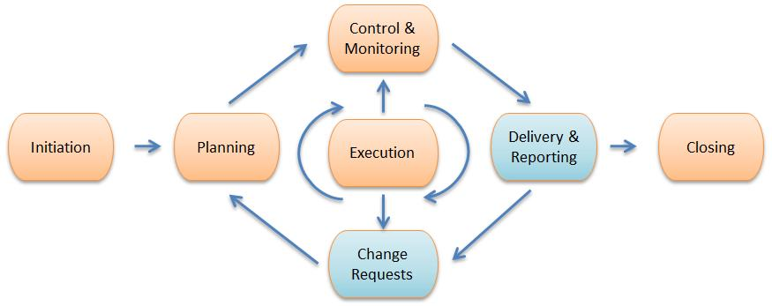
PROJECT MANAGEMENT PRACTICES
  Project management is the application of knowledge, skills, tools and techniques to a broad range of activities to achieve a stated objective.
  Project management life cycle are: initiating, planning, executing, controlling, monitoring and closing a project.
  Requests for major projects should be submitted to and prioritized by an IT steering committee. The committee then identifies a project manager.
  The project manager, who need not be an IT staff member, should be given complete operational control over the project and be allocated the appropriate resources, including IS professionals and other staff from user departments, for the successful completion of the project

Slide 2
PORTFOLIO/PROGRAM MANAGEMENT
  A project portfolio is defined as all of the projects being carried out in an organization at a given point in time.
  A program is a group of projects and tasks that are closely linked together through common strategies, objectives, budgets and schedules.
  Portfolios, programs and projects are often controlled by a project management office (PMO), which governs the processes of project management but are not typically involved in the management of the content.
  Like projects, programs have a limited time frame (i.e., a defined start and end date) and organizational boundaries.
  A differentiator is that programs are more complex, usually have a longer duration, a higher budget and higher risk associated with them, and are of higher strategic importance.
  A typical IS-related program may be the implementation of a large-scale enterprise resource planning (ERP) system that includes projects that address technology infrastructure, operations, organizational realignment, business process reengineering (BPR) and optimization, training, and development.

Slide 3
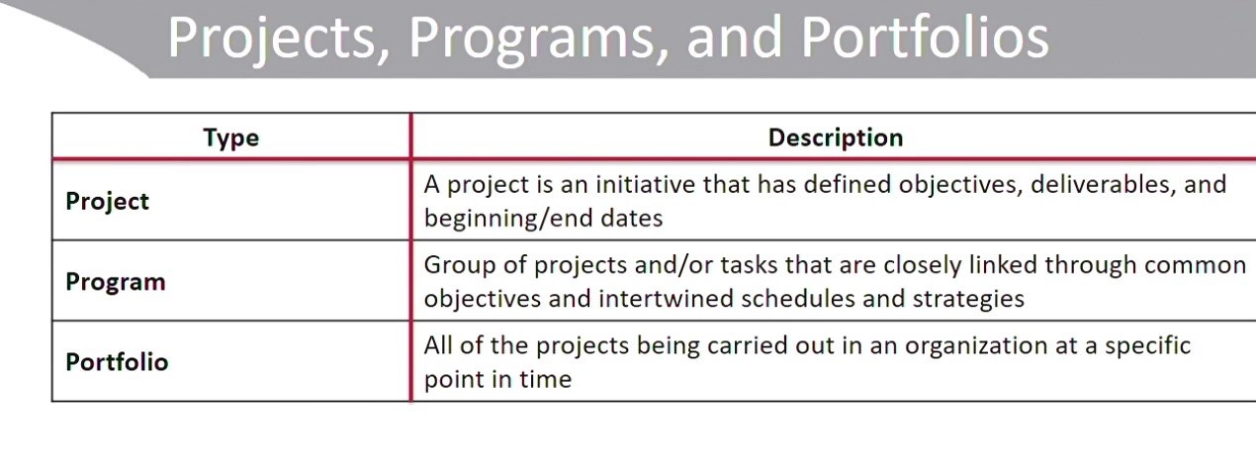
Project Portfolio Database
  A project portfolio database is mandatory for project portfolio management.
  It must include project data such as owner, schedules, objectives, project type, status and cost.
  Project portfolio management requires specific project portfolio reports. Typical project portfolio reports are a project portfolio bar chart, a profit versus risk matrix and a project portfolio progress graph.

Slide 4
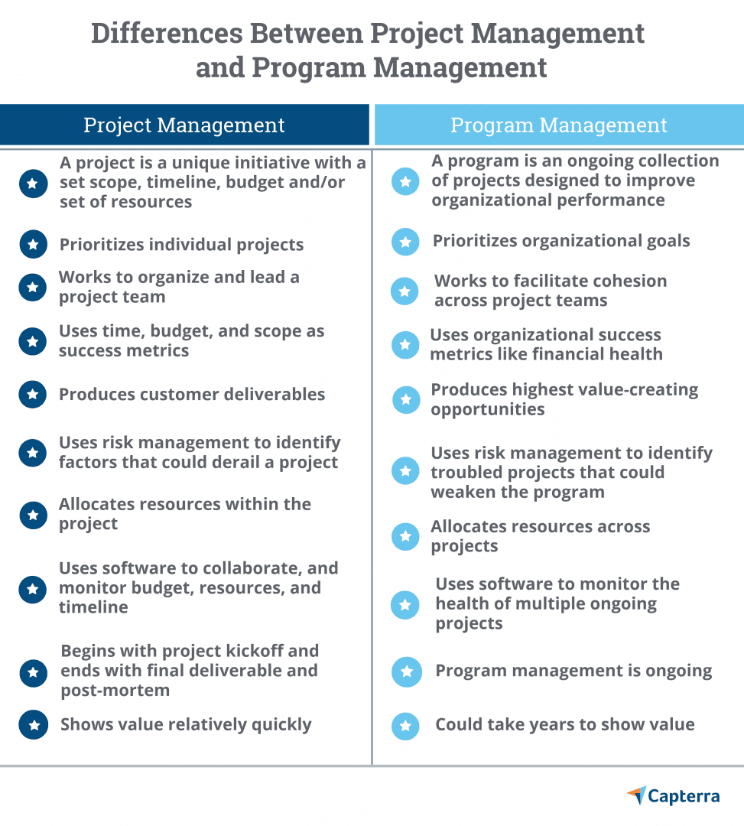

Slide 5
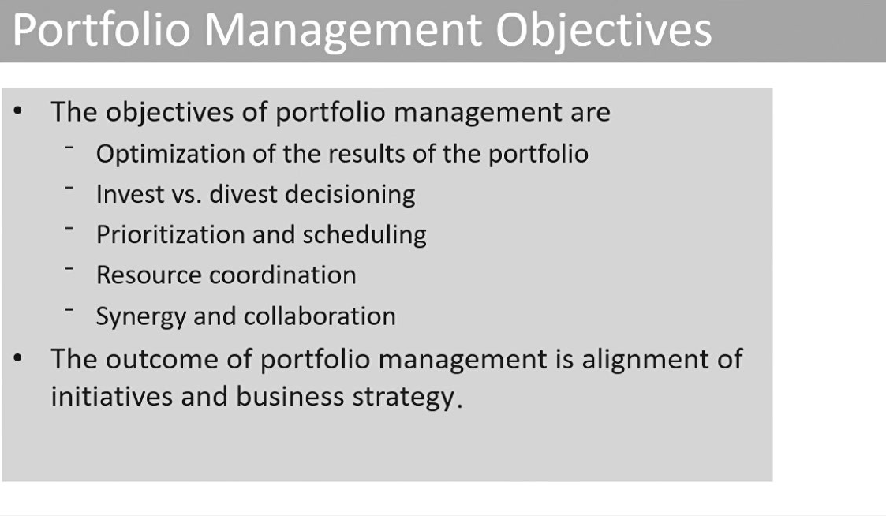

Slide 6
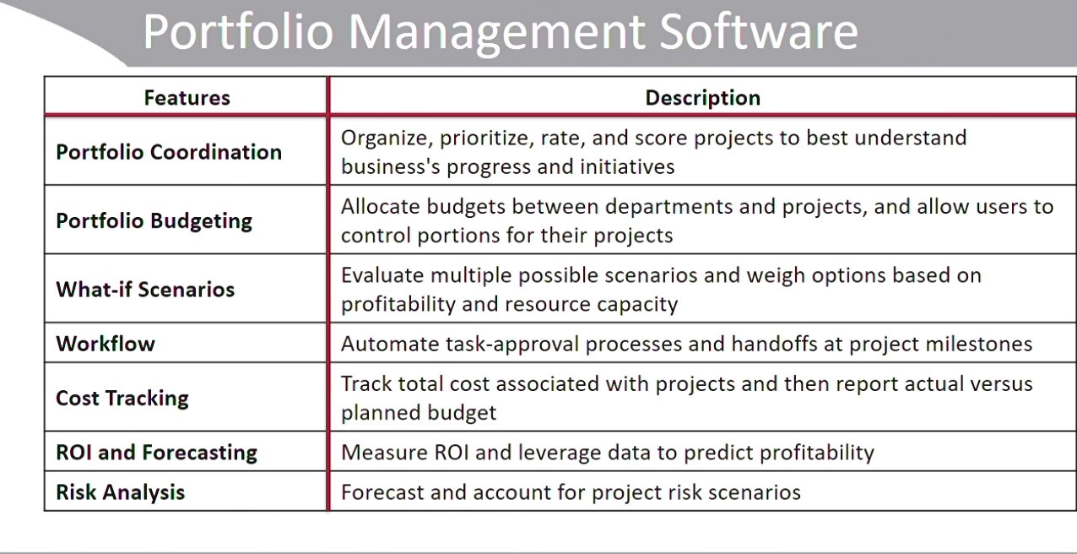
8 Best Project Portfolio Management (PPM)
https://kissflow.com/project/project-portfolio-management-software-tools/

Slide 7
PROJECT CLOSING
  At this point, The project sponsor should be satisfied that the system produced is acceptable and ready for delivery.
  Key questions to consider include:
    When will the project manager issue the final project closure notification?
    What will the project manager do for risk and issues that remain open?
    Who will pick up these actions and how will these be funded?
  Hand-off of relevant documentation and duties will occur at this stage, and the project team and other relevant stakeholders will identify lessons learned from the project.
  Review may be a formal process such as a post-project review.
  A post implementation review, in contrast, is typically completed after the project has been in use (or in “production”) for some time—long enough to realize its business benefits and costs and measure the project’s overall success and impact on the business units.
  Metrics used to quantify the value of the project include total cost of ownership (TCO) and ROI.

Slide 8
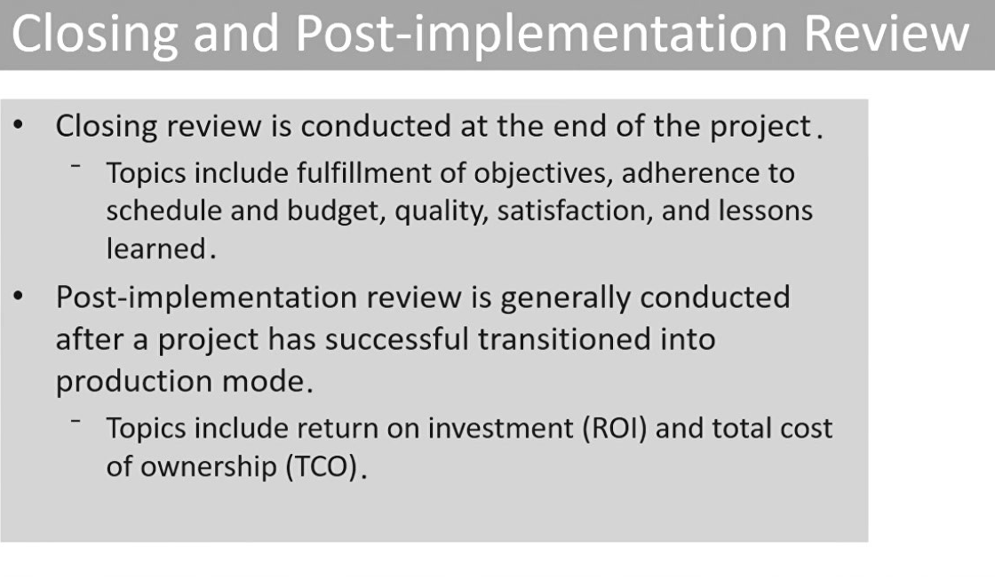

Slide 9

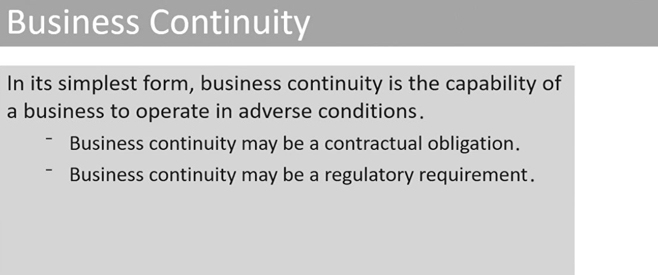

Slide 10
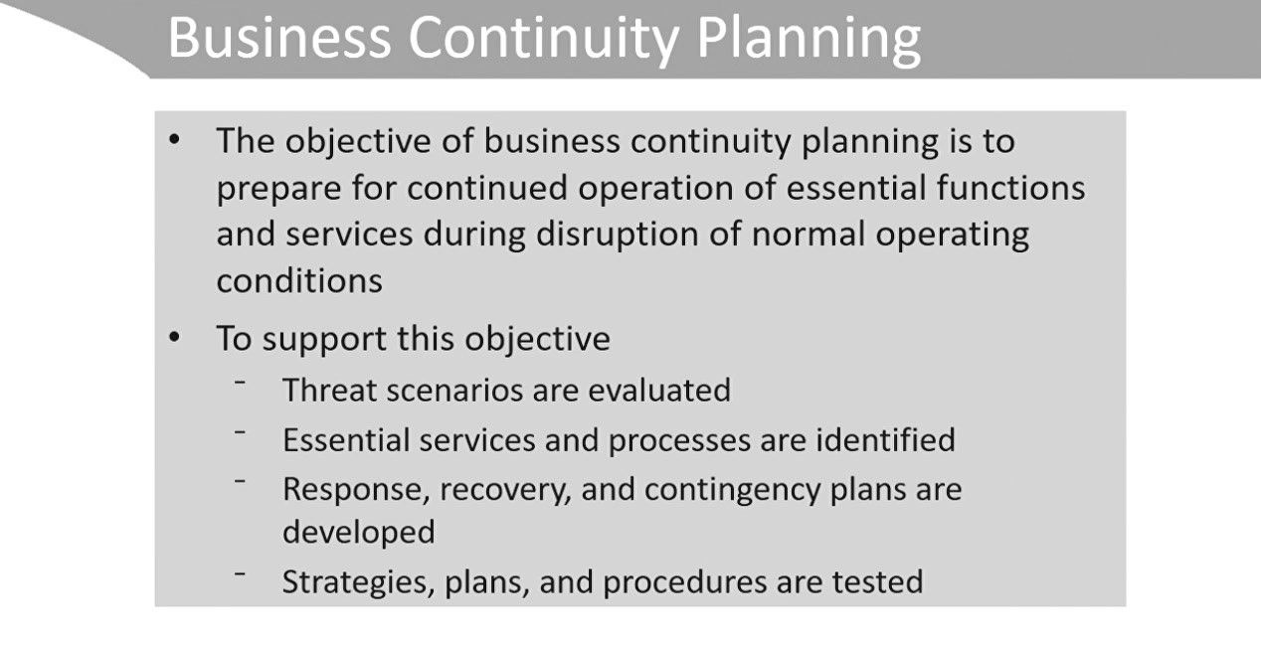

Slide 11
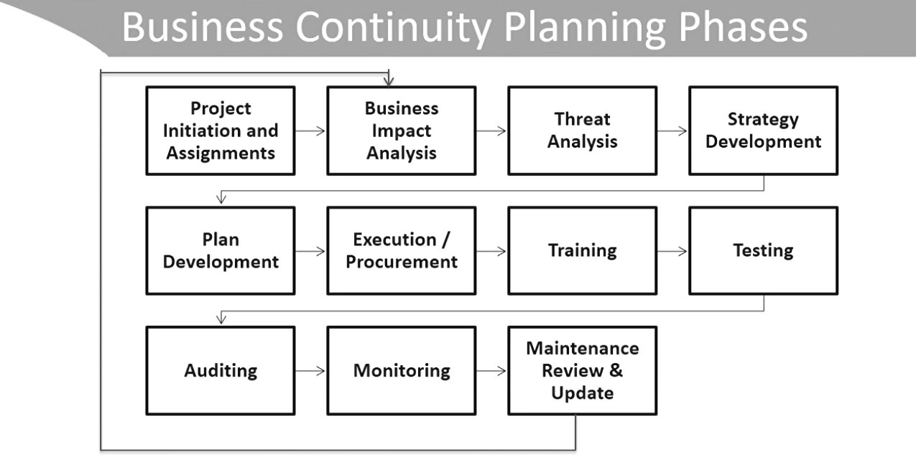

Slide 12
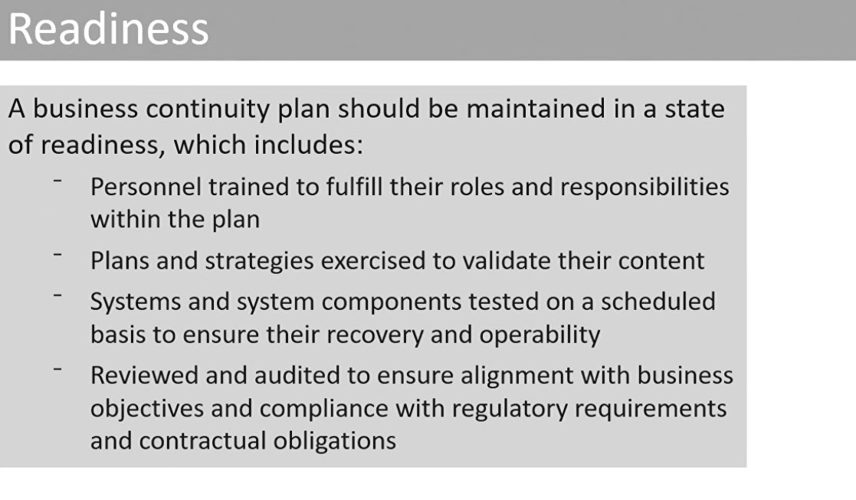

Slide 13
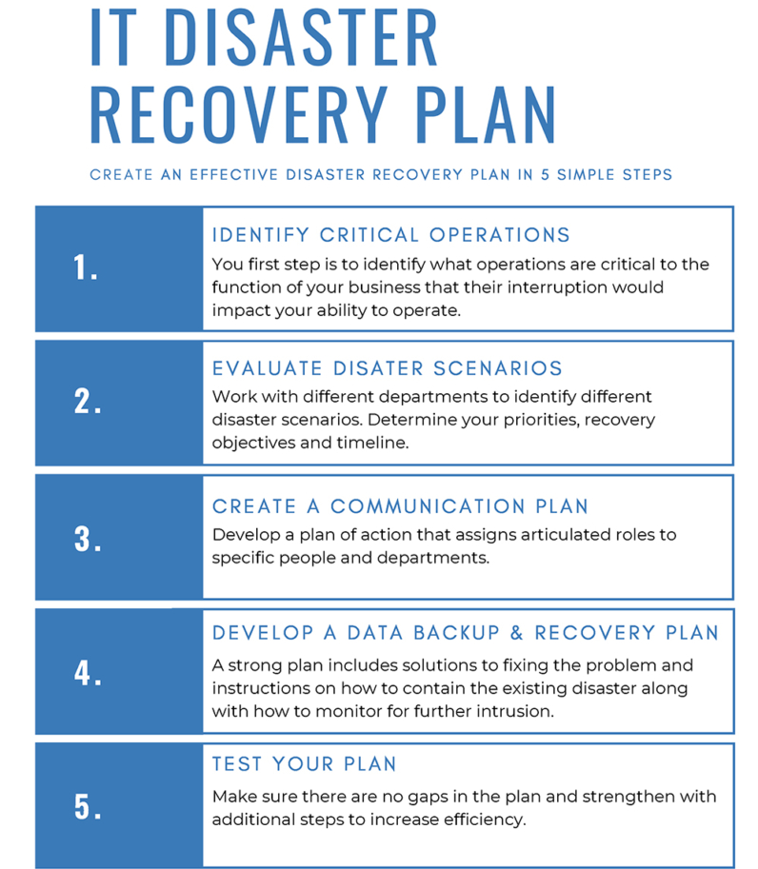
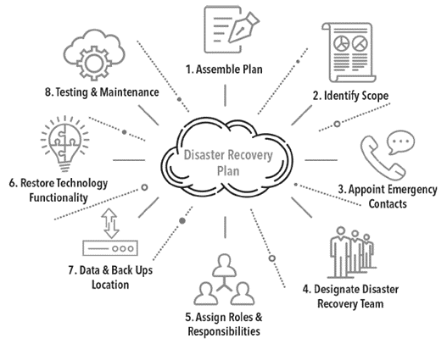
4.16 DISASTER RECOVERY PLANS
  Disaster recovery planning, is an element of an internal control system established to manage availability and restore critical processes/IT services in the event of interruption.

Slide 14
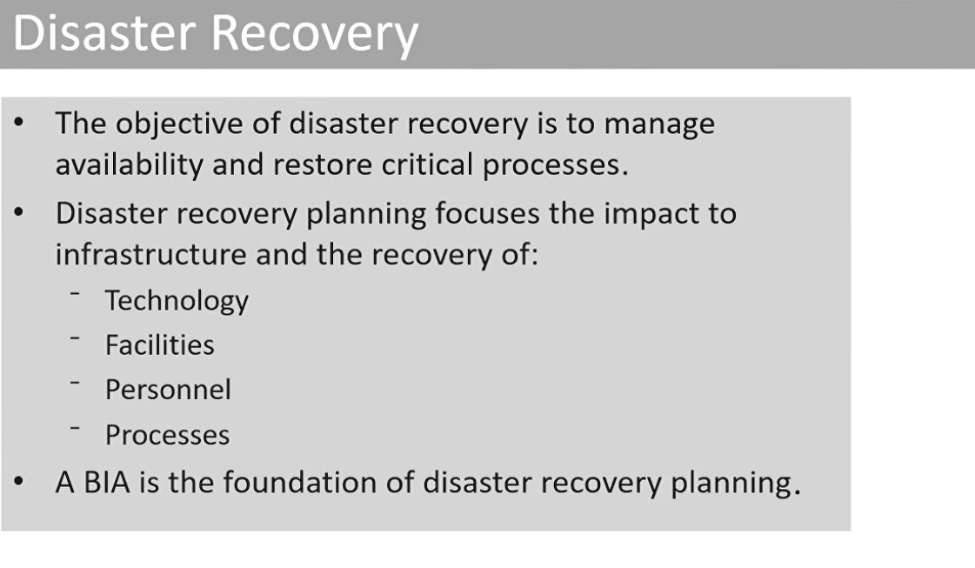

Slide 15
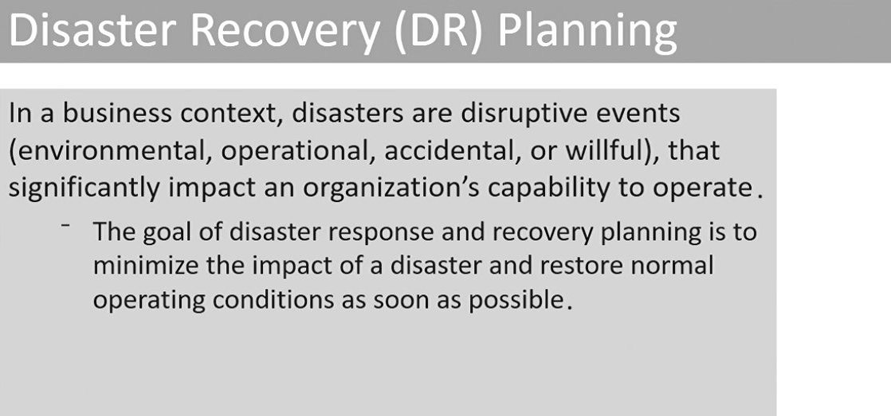

Slide 16
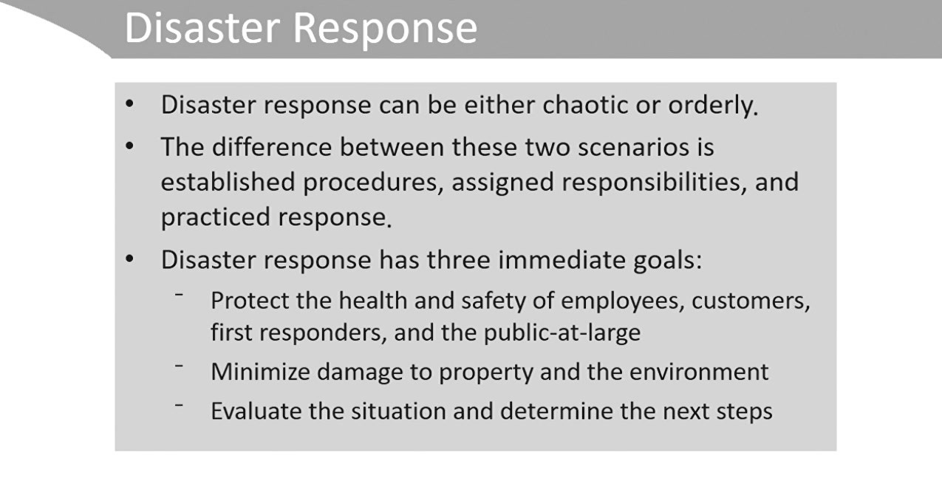

Slide 17
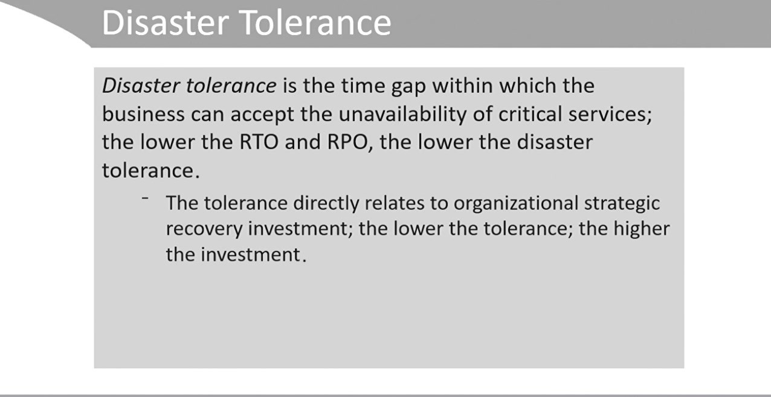

Slide 18
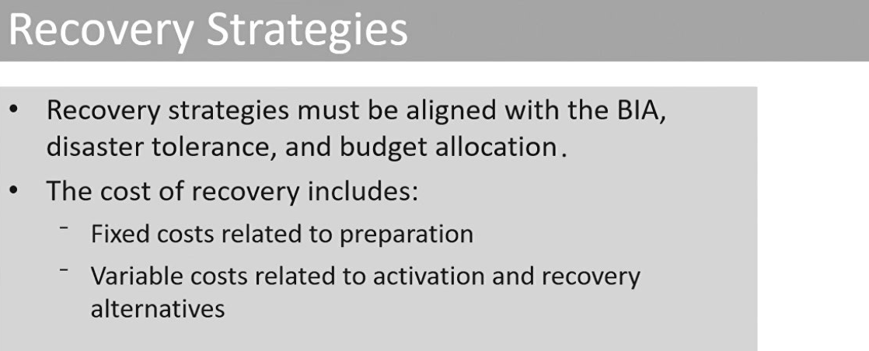

Slide 19
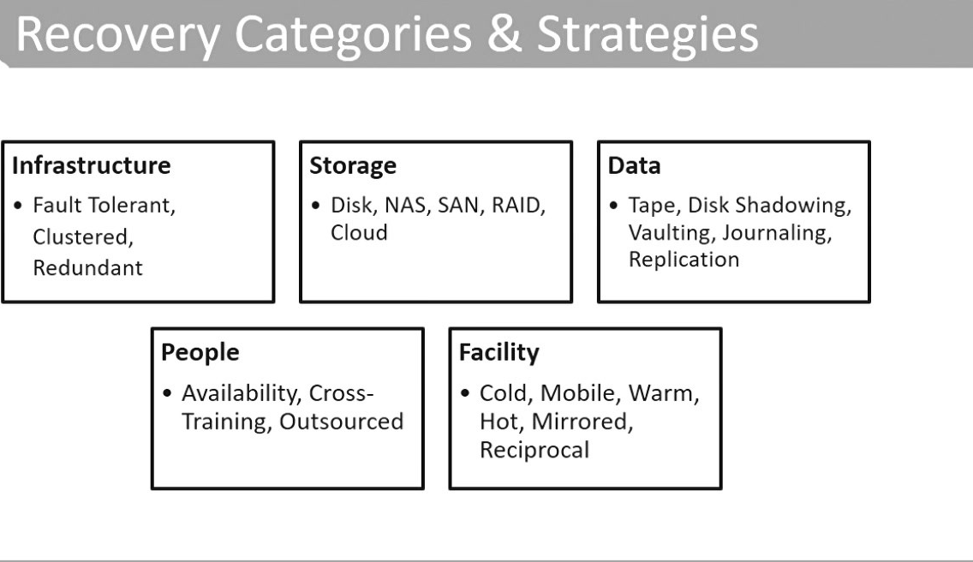

Slide 20
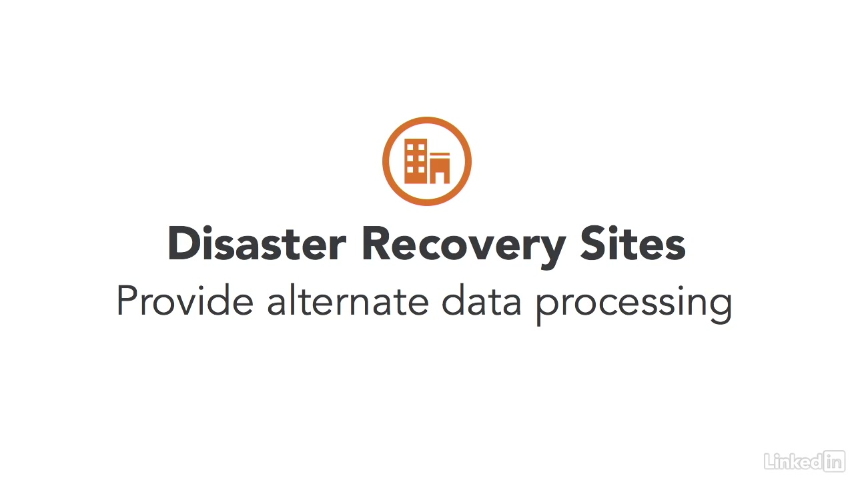

Slide 21
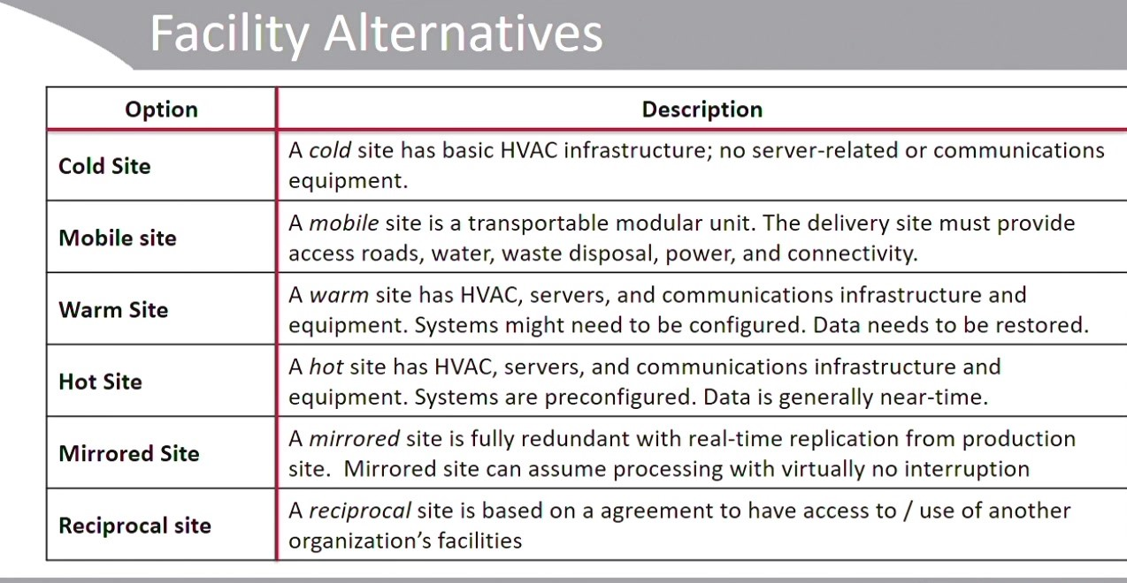

Slide 22


Slide 23


Slide 24
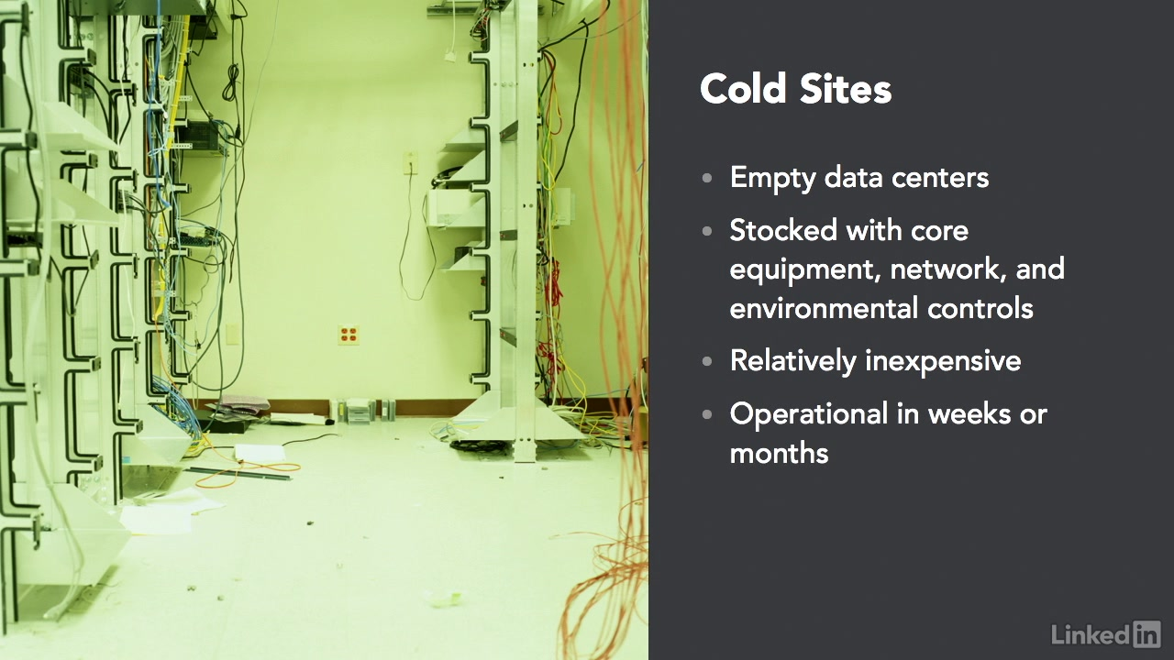

Slide 25
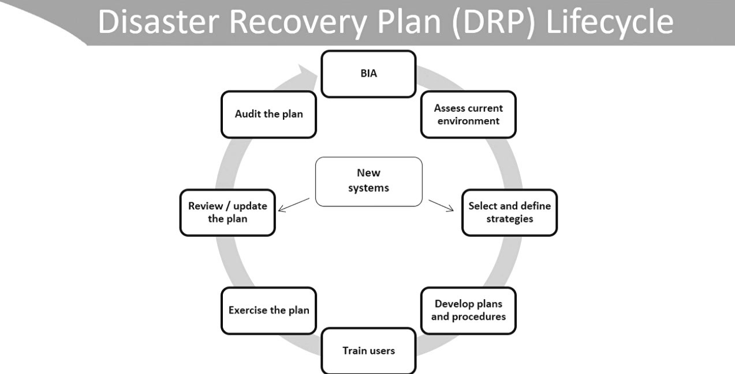

Slide 26
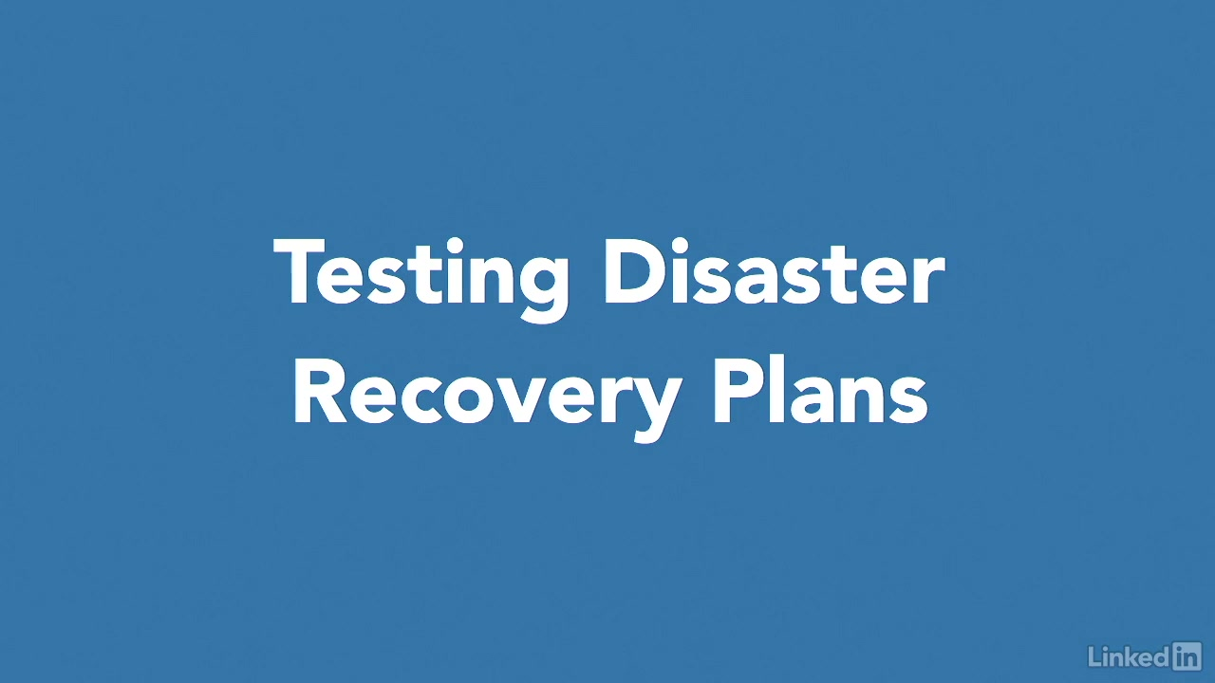

Slide 27
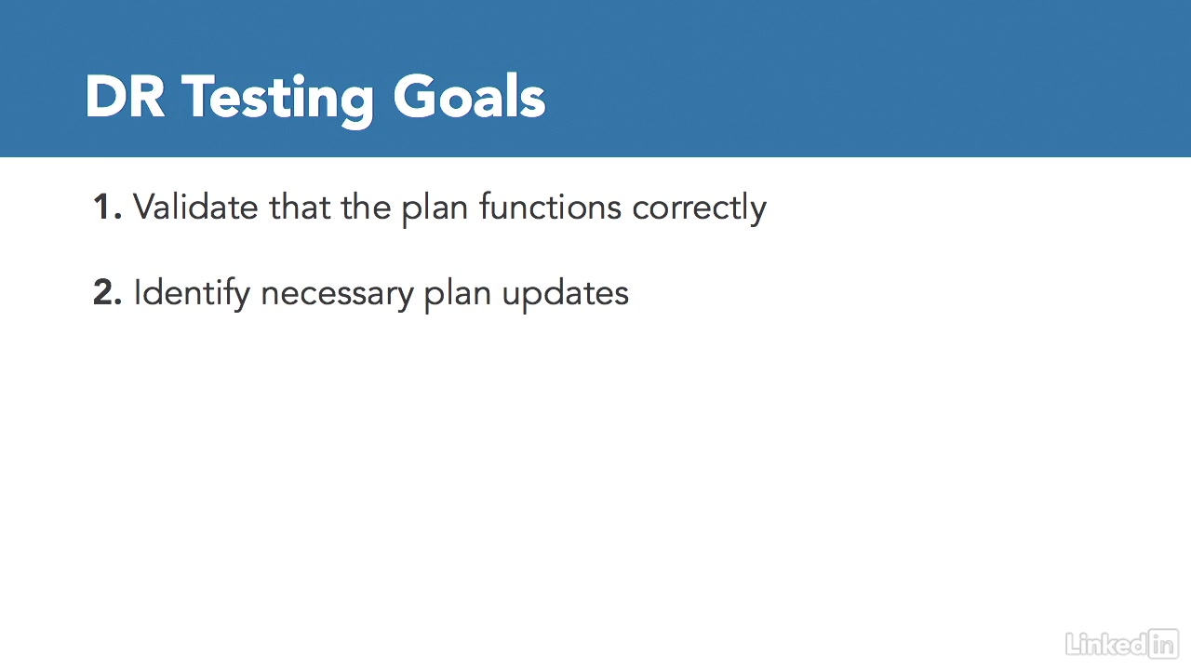

Slide 28
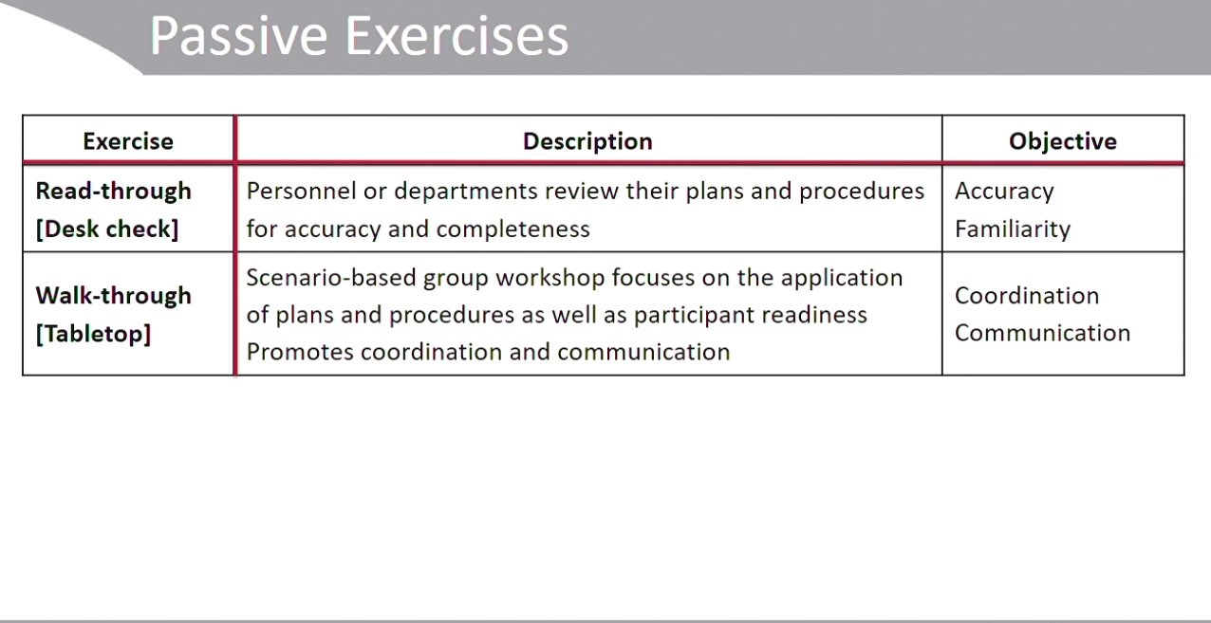

Slide 29


Slide 30


Slide 31
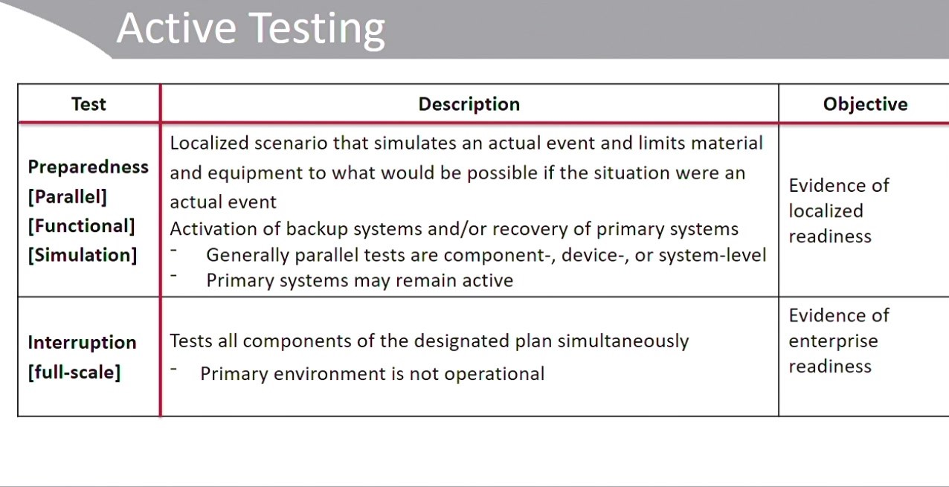

Slide 32


Slide 33


Slide 34


Slide 35

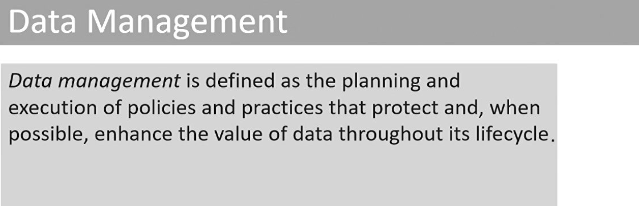

Slide 36
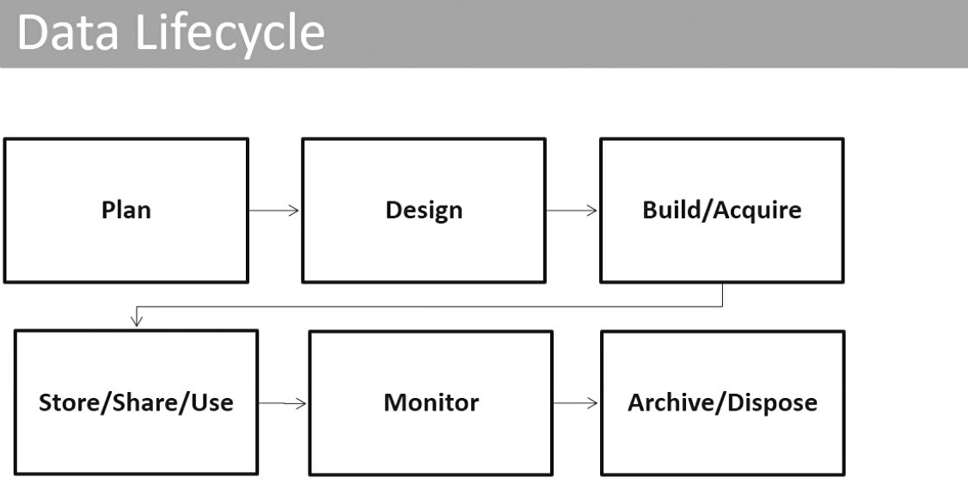
Data Life Cycle
  Data life cycle management describes the stages that data go through in the course of existence in an organization.

Slide 37
Plan
  The phase in which the creation, acquisition and use of the information resource is prepared.
  Activities in this phase include
    understanding information use in the respective business processes,
    determining the value of the information asset and its associated classification,
    identifying objectives and planning the information architecture.
Design
  The phase in which more detailed work is done in specifying how the information will look and how systems processing the information will have to work.
  Activities in this phase may refer to the development of standards and definitions (e.g., data definitions, data collection, access, storage procedures, metadata characteristics and data classification).

Slide 38
Build/acquire
  The phase in which the information resource is acquired.
  Activities in this phase may refer to the creation of data records,
  The purchase of data and the loading of external files.
Use/operate
This phase includes:
Store—The phase in which information is held electronically or in hard
copy (or even just in human memory).
Share—The phase in which information is made available for use
through a distribution method
Use—The phase in which information is used to accomplish (IT-related
and thus enterprise) goals.
Monitor
  The phase in which it is ensured that the information resource continues to work properly (i.e., to be valuable).
  Activities in this phase may refer to keeping information up to date and other kinds of information management activities (e.g., enhancing, cleansing, merging and removing duplicate information in data warehouses).

Slide 39
Dispose
  The phase in which the information resource is transferred or retained for a defined period, destroyed, or handled as part of an archive as needed.
  Activities in this phase may refer to information retention, archiving or destroying.
The IS auditor should ensure that
  the quality of the data allows the organization to meet its strategic objectives.
  Are the data being captured and processed to required standards?
  configuration of the organization’s applications and database management systems is in line with organizational objectives.
  For example, are data being archived, retained or destroyed in line with a data retention policy?

Slide 40
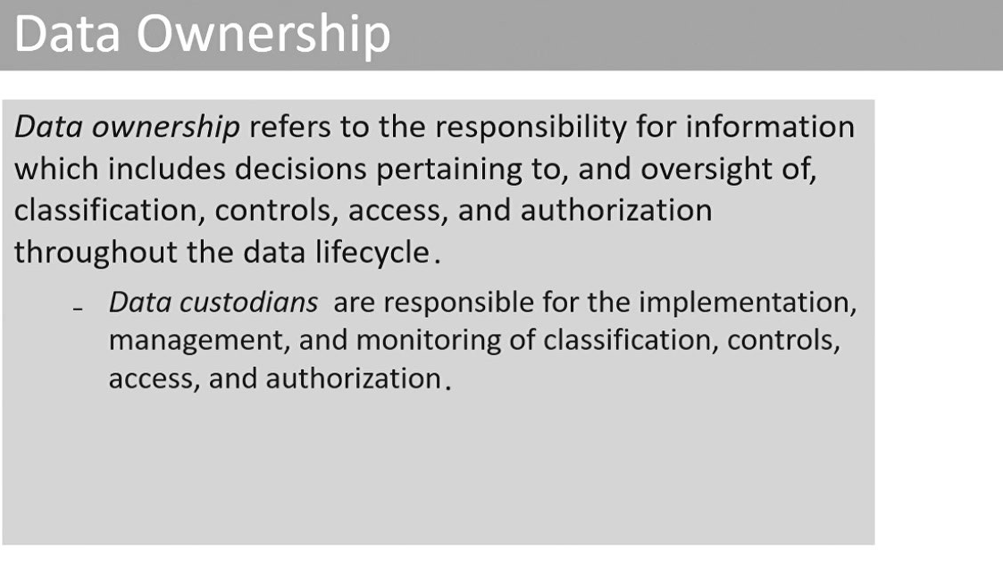

Slide 41
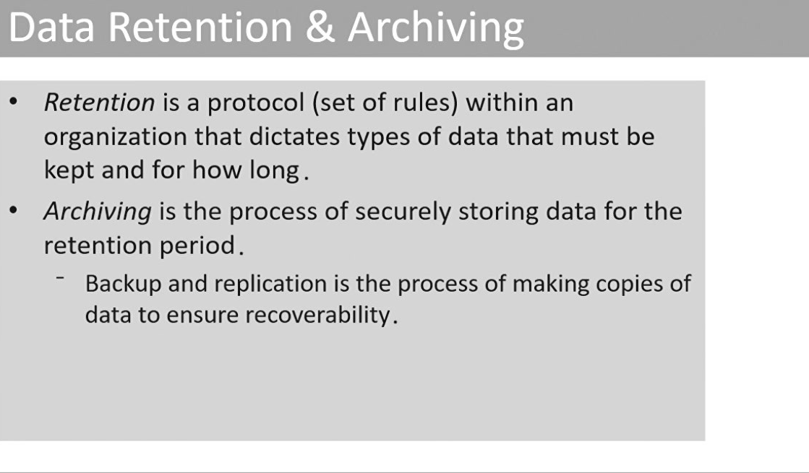

Slide 42
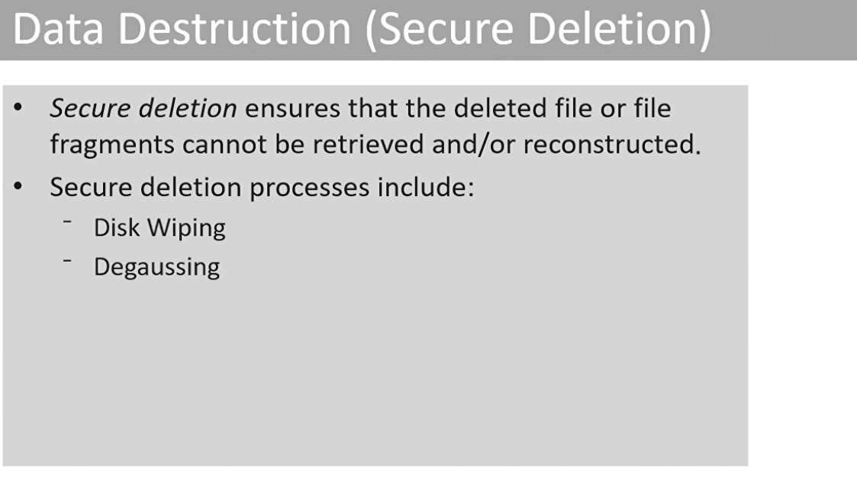

Slide 43
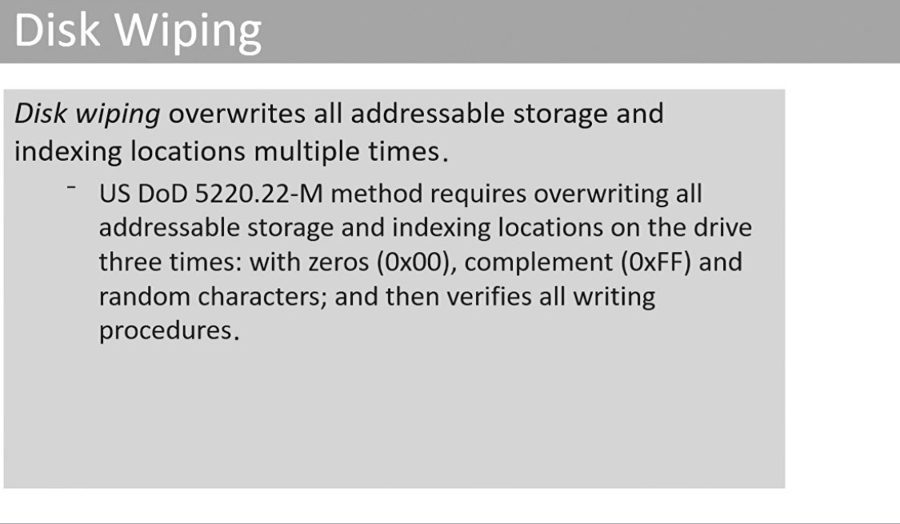

Slide 44
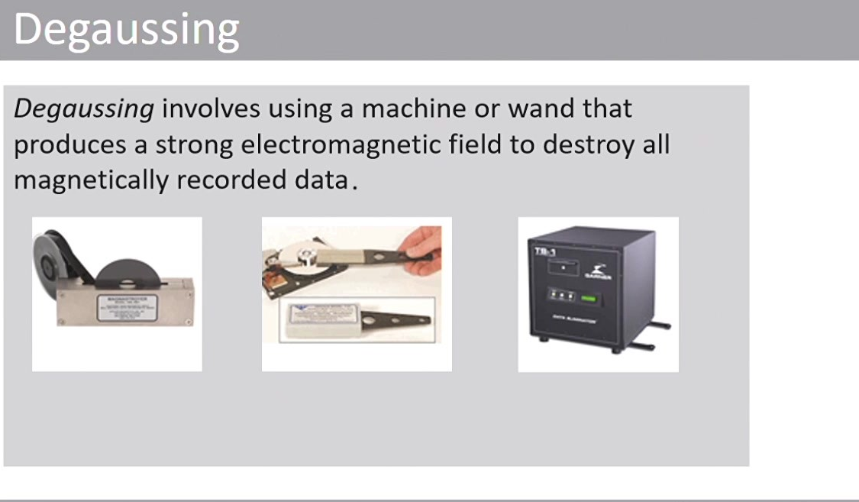

Slide 45
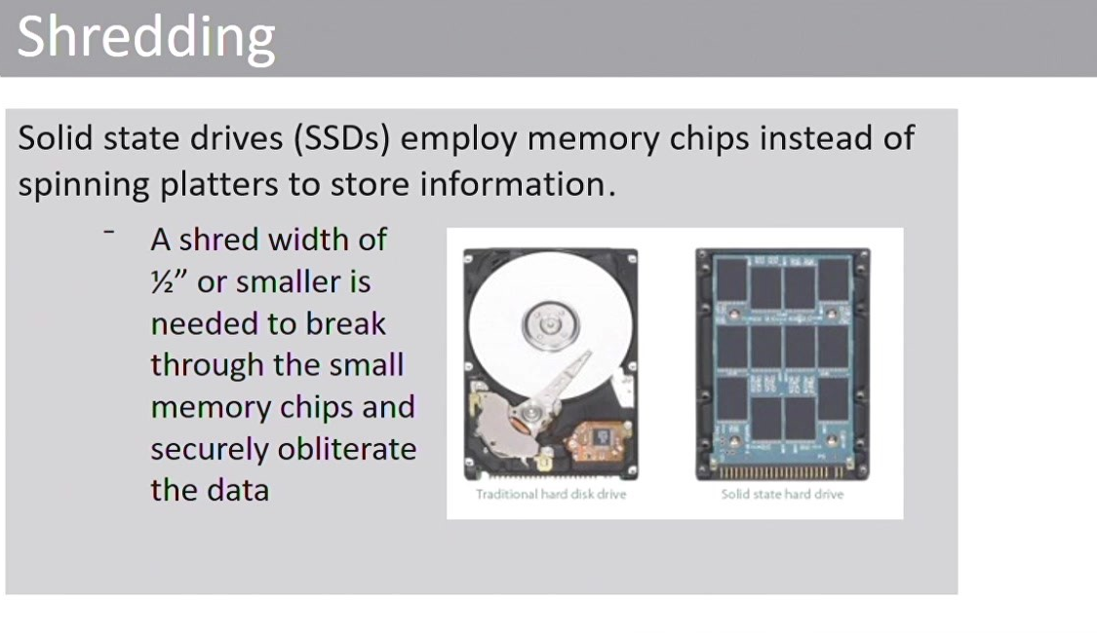

Slide 46
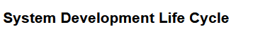


Slide 51
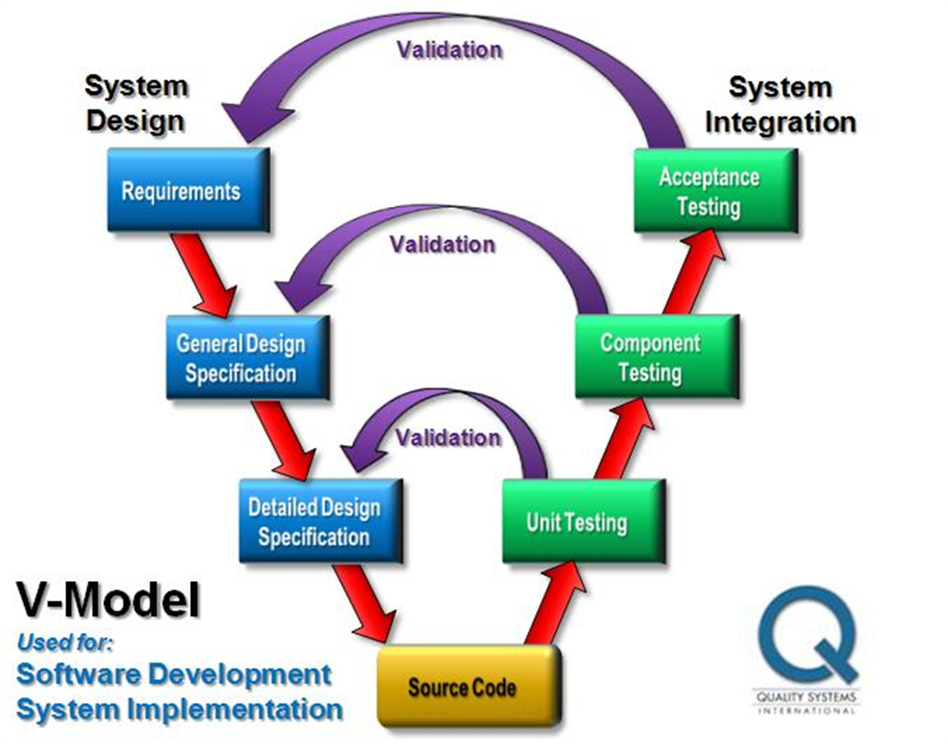
verification and validation model,
  also called the V-model, also emphasizes the relationship between development phases and testing levels.
  The most granular testing—the unit test—occurs immediately after programs have been written. Following this model, testing occurs to validate the detailed design.

Slide 52
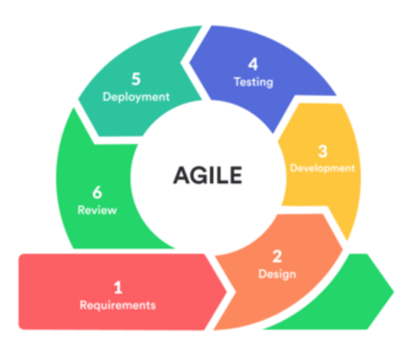
The Agile Iteration Workflow
Agile Software Development Life Cycle (SDLC) is the combination of both iterative and incremental process models.
It focuses on process adaptability and customer satisfaction by rapid delivery of working software product.
Agile SDLC breaks down the product into small incremental builds.
  A typical iteration (repetition, duplication) process flow can be visualized as follows:
  Requirements - Define the requirements for the iteration based on the product backlog (core, heart), customer and stakeholder feedback
  Development - Design and develop software based on defined requirements
  Testing - QA (Quality Assurance) testing, internal and external training, documentation development
  Delivery - Integrate and deliver the working iteration into production
  Feedback - Accept customer and stakeholder feedback and work it into the requirements of the next iteration

Slide 53
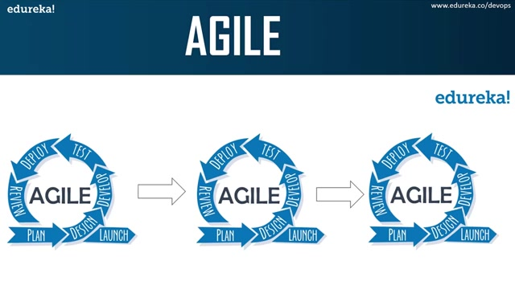
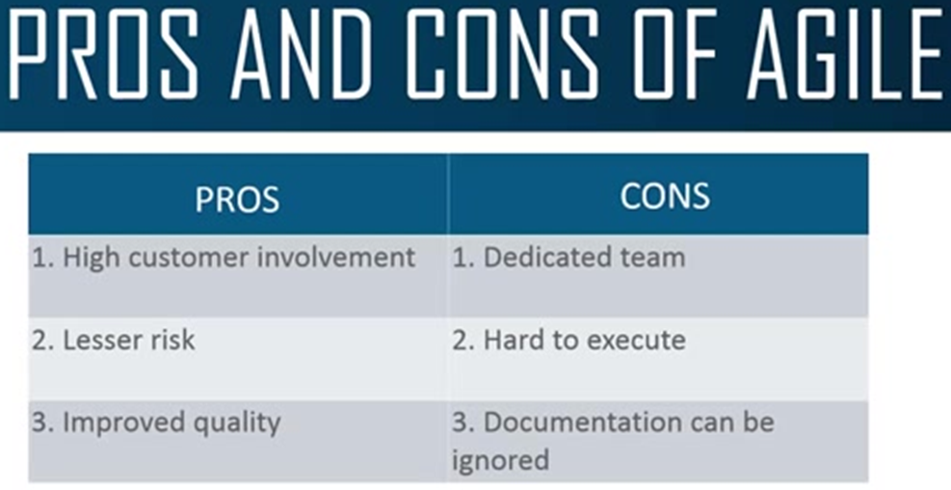

Slide 54
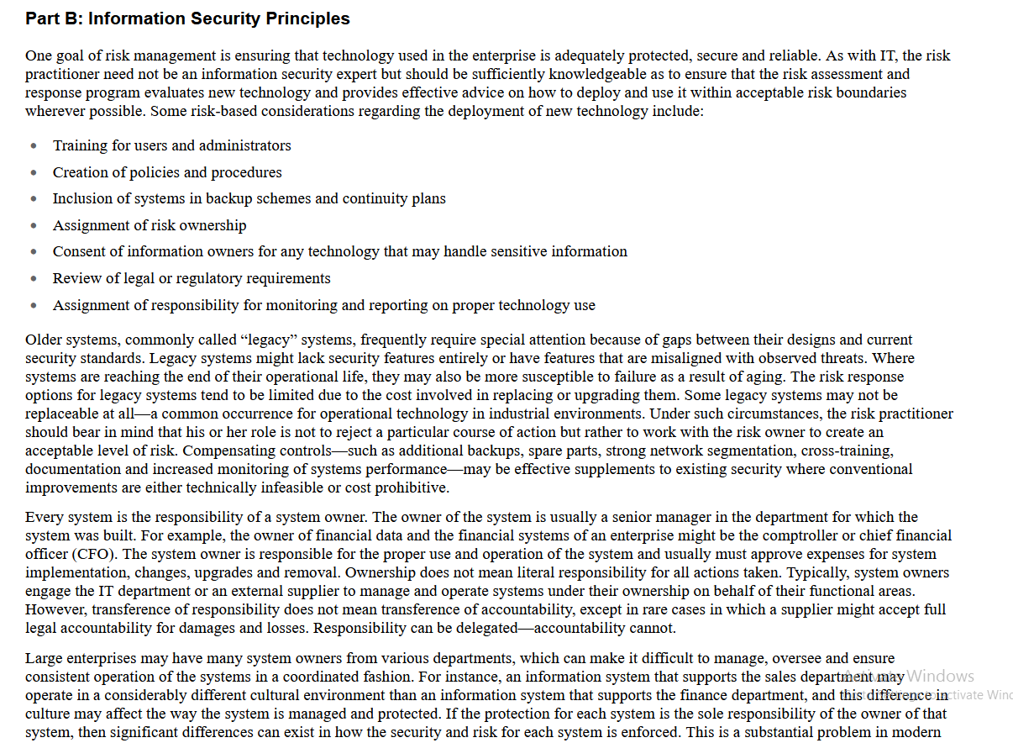
Information Security Concepts, Frameworks and Standards
  IT risk is often linked to information security, which is the protecting of information and information systems (including smart technology)from risk events.
  Information security controls are based on risk, and risk is the primary justification used to support information security activities.
  Some enterprises have a mature risk-management process that is able to quantify risk with a high level of accuracy.
  Often, the predicted impact of an undesired event occur results in only direct, immediate effects, whereas actual events are discovered long after the event has occurred (such as damage to reputation).

Slide 55
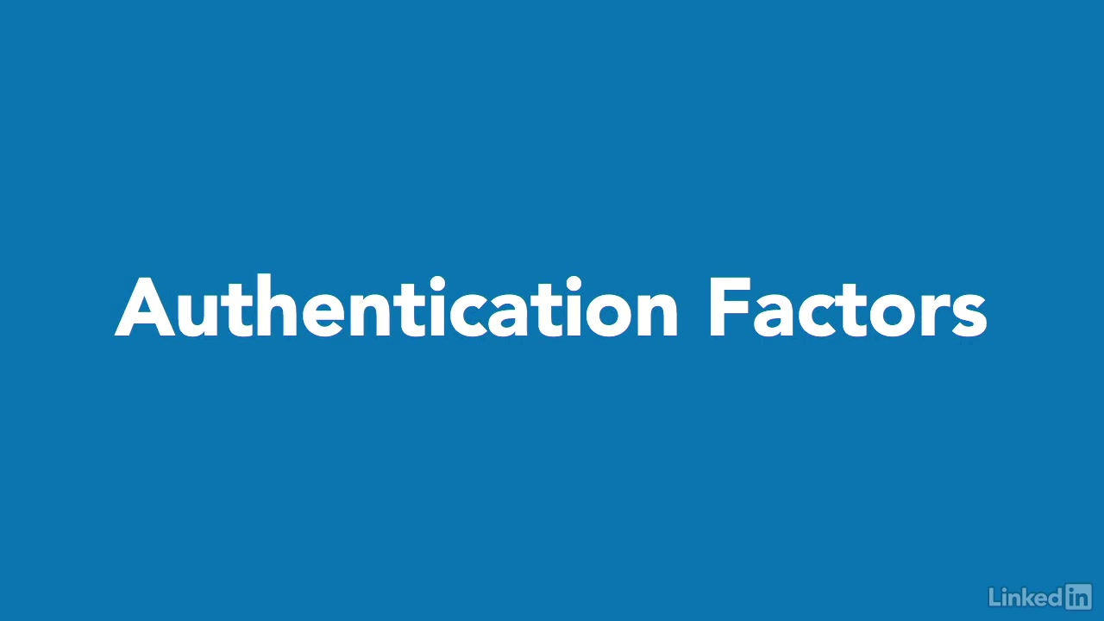

Slide 56
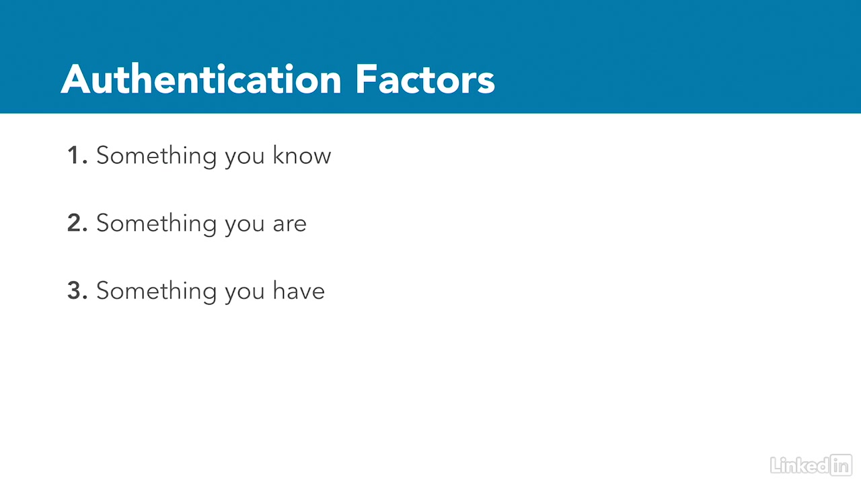

Slide 57
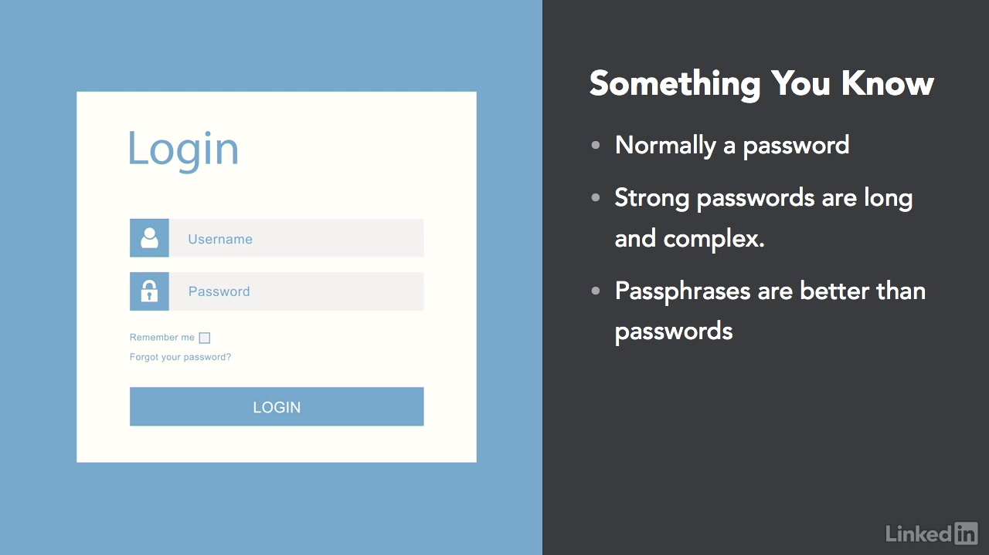
One of the best ways to create a strong password is to use a passphrase instead.
For example, you might choose the easily memorable phrase chocolate-covered strawberries are for me, and write it like this instead.
That gives you a strong complex password that is easy to remember and hard to guess.

Slide 58


Slide 59
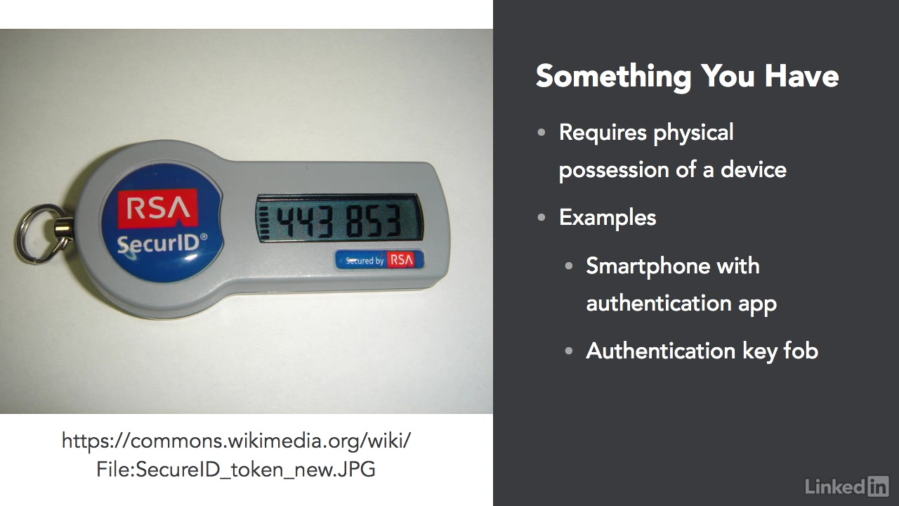

Slide 60
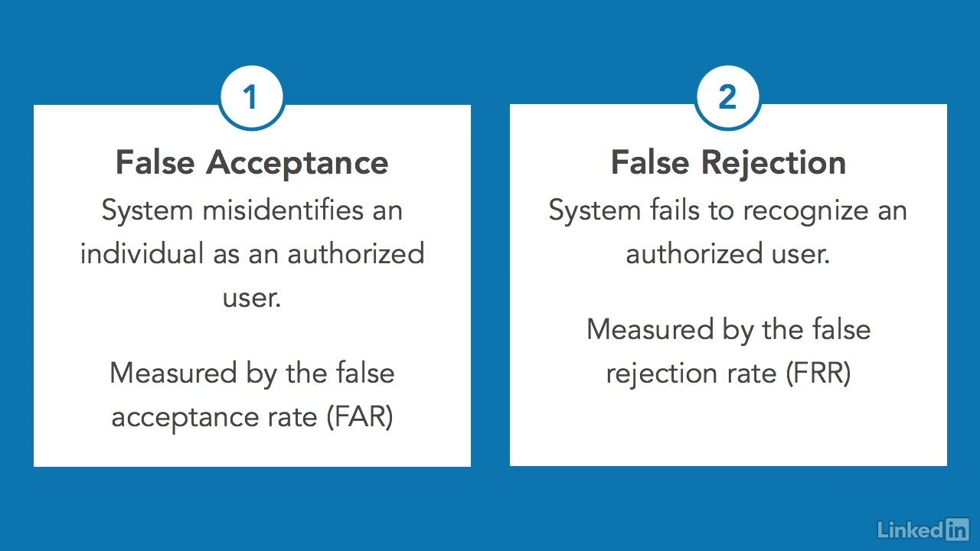
The strength of techniques used by each of these authentication factors may be measured by the number of errors that it generates.
There are two basic types of errors in authentication systems.
  False acceptance errors occur when the system misidentified an individual as an authorized user and grants access that should be denied.
  This is a very serious error, because it allows unauthorized access to the system, device, information, or facility.
  The frequency of these errors is measured by the false acceptance rate, or FAR.
  False rejection errors occur when an authorized individual attempts to gain access to a system, but is incorrectly denied access by that system.
  This is not as serious as a false acceptance, because it does not jeopardize confidentiality or integrity. But it is still a serious error, because it jeopardizes the availability of those resources to authorized users. The frequency of these errors
  is measured by the false rejection rate, or FRR.

Slide 62
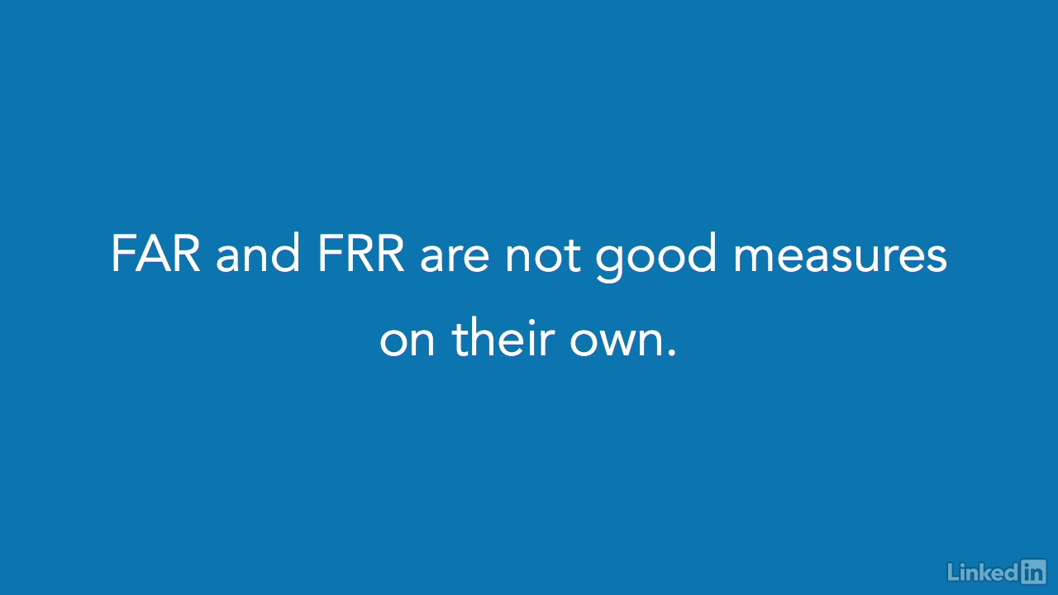
The FAR and FRR are not, by themselves, good measures of the strength of an authentication factor, because they may easily be manipulated.
On one extreme, administrators may configure the system to simply admit nobody at all, giving it a perfect false acceptance rate, but, also, a very high false rejection rate.
Similarly, if the system allows anyone access, it has a perfect false rejection rate, but an unacceptably high false acceptance rate.

Slide 63
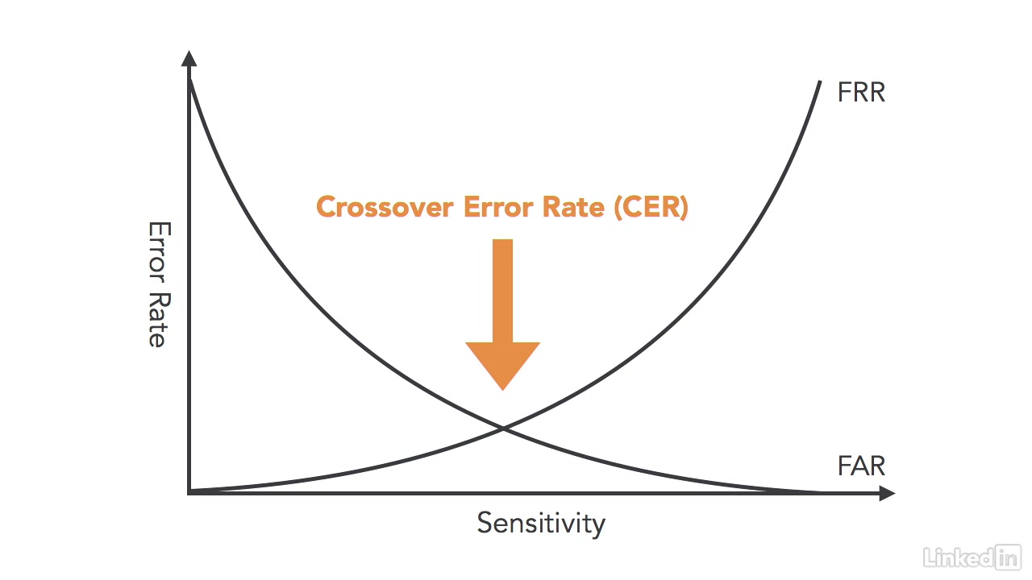
The solution to this measurement problem is to use a balanced measure of authentication strength called the crossover error rate, or CER.
The crossover error rate is the error frequency that occurs when administrators tune the system to have equal false acceptance and false rejection rates.

Slide 64
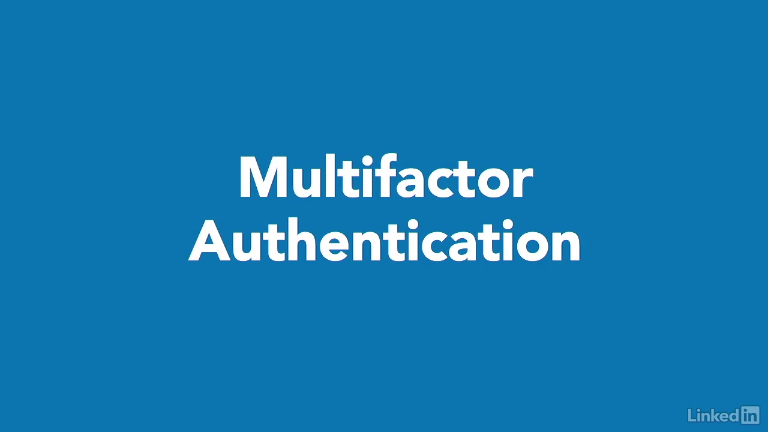

Slide 65
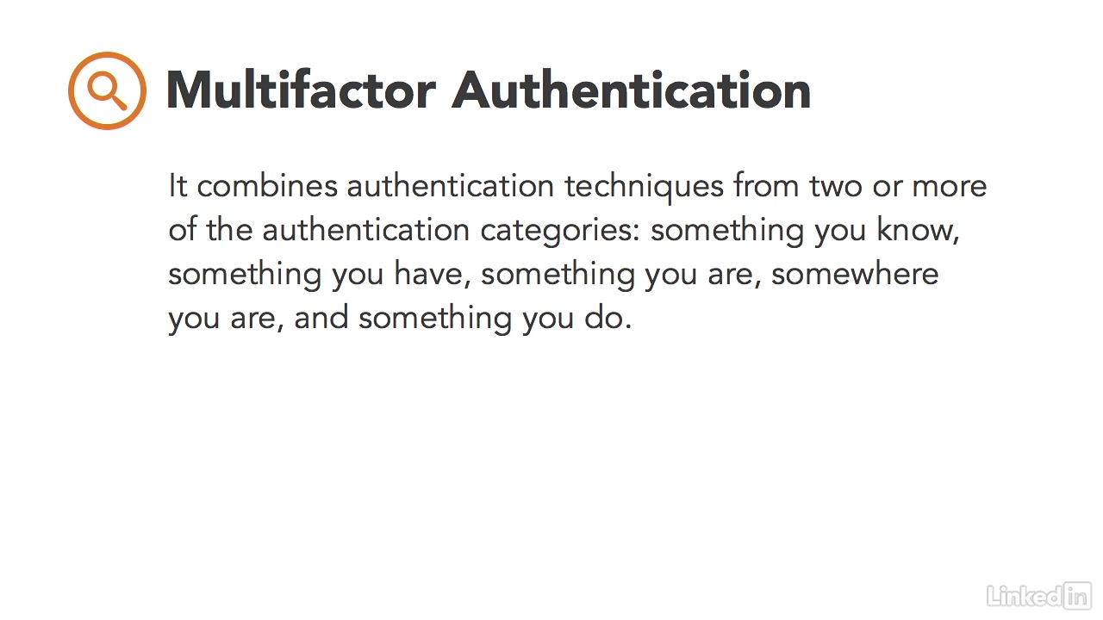

Slide 66
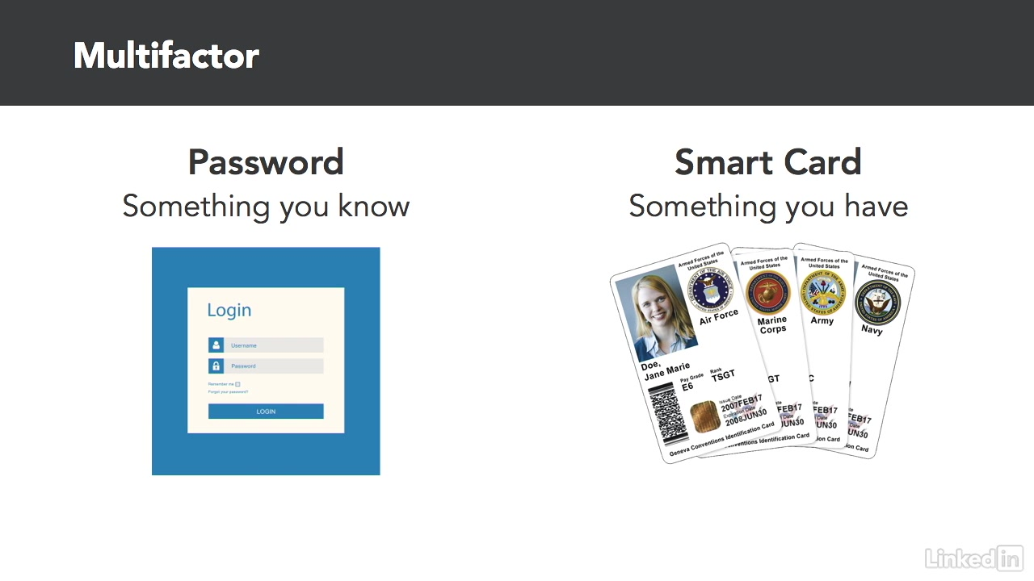

Slide 67


Slide 68


Slide 69


Slide 70


Slide 71


Slide 72


Slide 73


Slide 74


Slide 75


Slide 76


Slide 77


Slide 78


Slide 79


Slide 80


Slide 81


Slide 82


Slide 83


Slide 84


Slide 85


Slide 86



Slide 87


Slide 88


Slide 89


Slide 90


Slide 91


Slide 92


Slide 93


Slide 94


Slide 95


Slide 96


Slide 97


Slide 98

The Generally Accepted Privacy Principles, or GAPP were developed through a collaboration between four major industry organizations.

Slide 99



Slide 100



Slide 101



Slide 102



Slide 103


Each of these 10 GAPP principles plays an important role in developing a comprehensive information privacy program.
Data owners should ensure that these principles are followed for each element of personal information under their control.

